Slide 1


Selected Topics 2 Assignment #2
presentation
Active Deep Learning

Slide 2
Selected Topics 2 Assignment #2
presentation
Active Deep Learning
Prepared by
ID | Name
20200031 | Ahmed Ali Ali
20200347 | Omar Salah Eldeen
20200597 | Kareem Sayed Salah
20200807 | Ahmed Ashraf Zaki

Slide 3

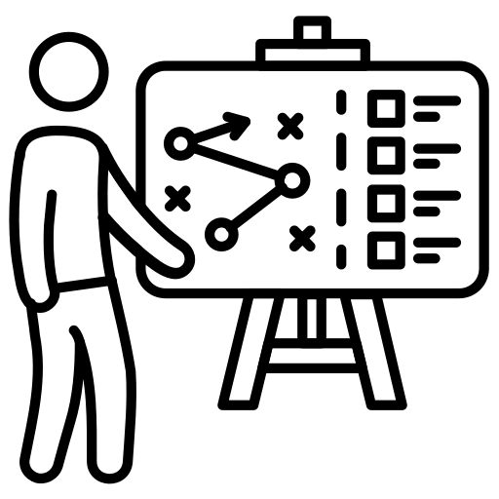




Introduction
Datasets
AGENDA
AL Strategies
Models
Evaluation

Slide 4
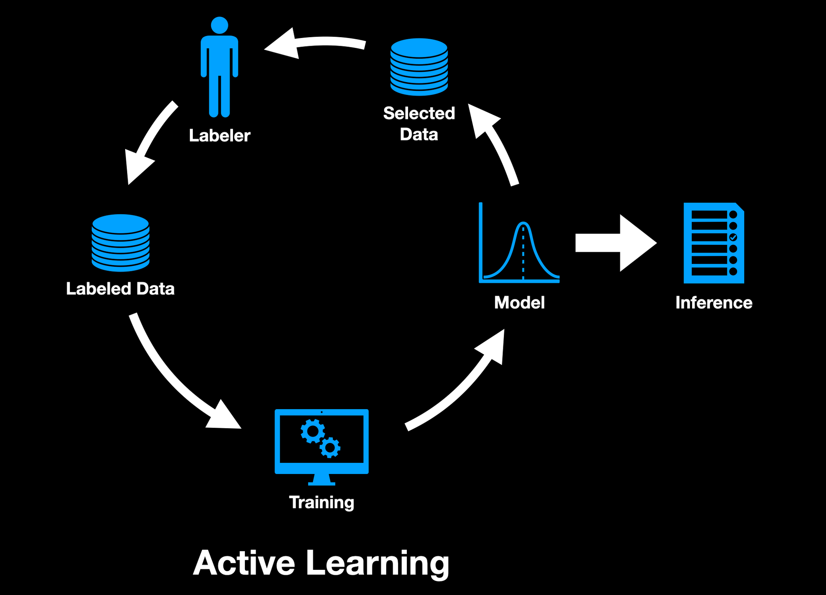
Introduction
Often times it is not ideal with regard to providing sample lables in machine learning and deep learning. The process of assigning lables to samples usually costs a lot of effort and is expensive, so in order to solve this problem, active learning has developed several methods that will help in selecting samples of interest to query it is lables , this method has proven truly effective and is often superior to passive learning.

Slide 5
Introduction
Datasets
AGENDA
AL Strategies
Models
Evaluation

Slide 6
Datasets
1- Minst Fashion Dataset :
2- CIFAR-10 Dataset :
3- Imbalanced Minst Fashion Dataset :

Slide 7
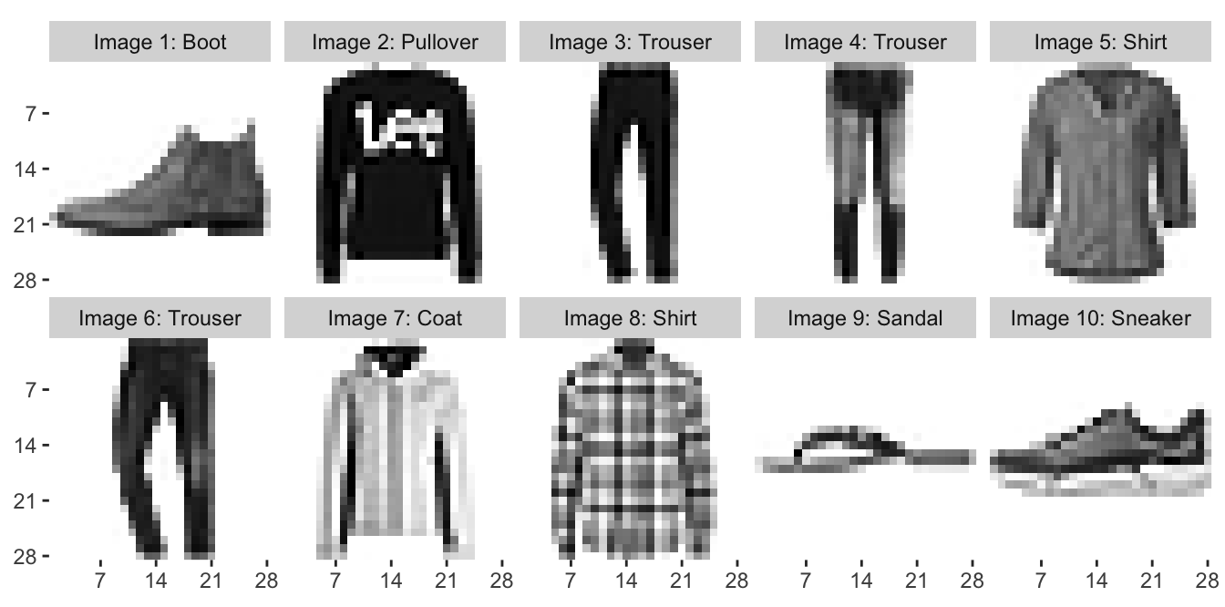
Datasets
1- Minst Fashion Dataset :
Minst Fashion It consists of grayscale images of fashion items, each associated with a corresponding label indicating the type of clothing or accessory depicted.
2- CIFAR-10 Dataset :
3- Imbalanced Minst Fashion Dataset :

Slide 8
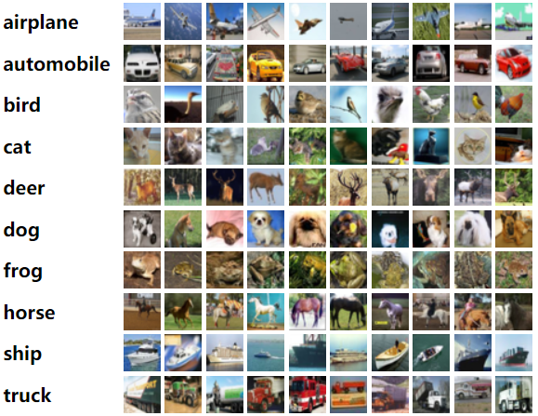
Datasets
1- Minst Fashion Dataset :
2- CIFAR-10 Dataset :
The CIFAR-10 dataset is a collection of 60,000 32x32 color images in 10 different classes, with 6,000 images per class
3- Imbalanced Minst Fashion Dataset :

Slide 9
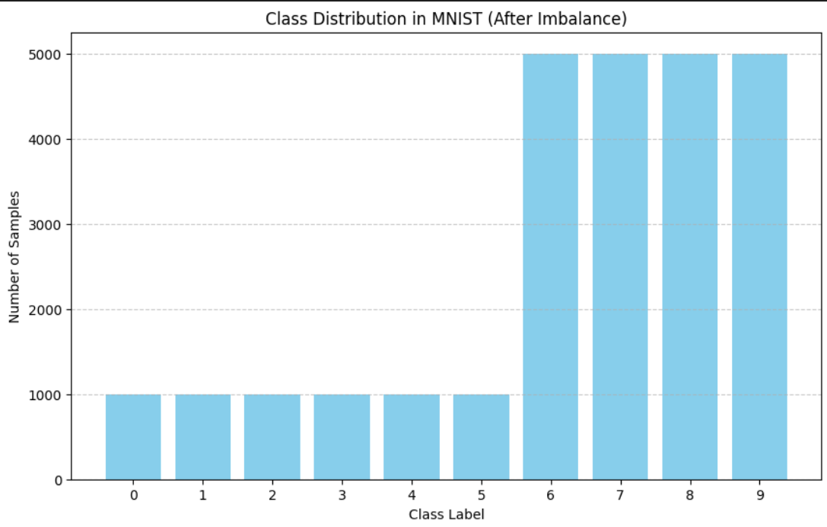
Datasets
1- Minst Fashion Dataset :
2- CIFAR-10 Dataset :
3- Imbalanced Minst Fashion Dataset :
The same Minst Fashion Dataset database, but it has unbalanced categories to measure how different strategies deal with this problem

Slide 10
Introduction
Datasets
AGENDA
AL Strategies
Models
Evaluation

Slide 11
AL Strategies
1- Random Sampling
2- Margin sampling
3- Entropy sampling
4- Uncertainty sampling (Least Confidence Sampling)
just query to labeling random samples from dataset

Slide 12
AL Strategies
1- Random Sampling
just query to labeling random samples from dataset.
2- Margin sampling
3- Entropy sampling
4- Uncertainty sampling (Least Confidence Sampling)

Slide 13
AL Strategies
1- Random Sampling
2- Margin sampling
The algorithm focuses on instances where the model's prediction is uncertain. In other words, the model is most uncertain when the margin between the probabilities assigned to the top two predicted classes is smallest.
3- Entropy sampling
4- Uncertainty sampling (Least Confidence Sampling)

Slide 14
AL Strategies
1- Random Sampling
2- Margin sampling
3- Entropy sampling
Entropy, is measure of uncertainty associated with a set of labels. In a classification problem, if a model is uncertain about the class label for a particular data point, it means that the distribution of probabilities across different classes is more spread out or uncertain.
4- Uncertainty sampling (Least Confidence Sampling)

Slide 15
AL Strategies
1- Random Sampling
2- Margin sampling
3- Entropy sampling
4- Uncertainty sampling (Least Confidence Sampling)
"Least Confident” The model selects cases about which it is least confident to label them. More specifically, the model predicts naming probabilities for each instance in the unnamed pool and identifies instances for which the predicted probability of the minimum.

Slide 16
Introduction
Datasets
AGENDA
AL Strategies
Models
Evaluation

Slide 17
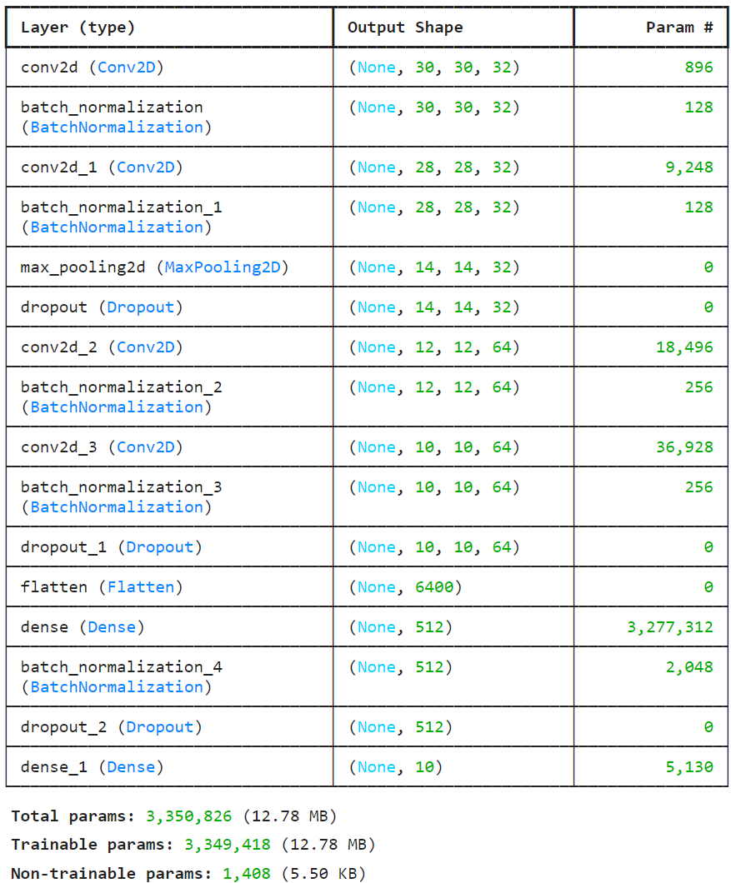
Models
Active & Passive Learning Model Arc

Slide 18
Introduction
Datasets
AGENDA
AL Strategies
Models
Evaluation

Slide 19
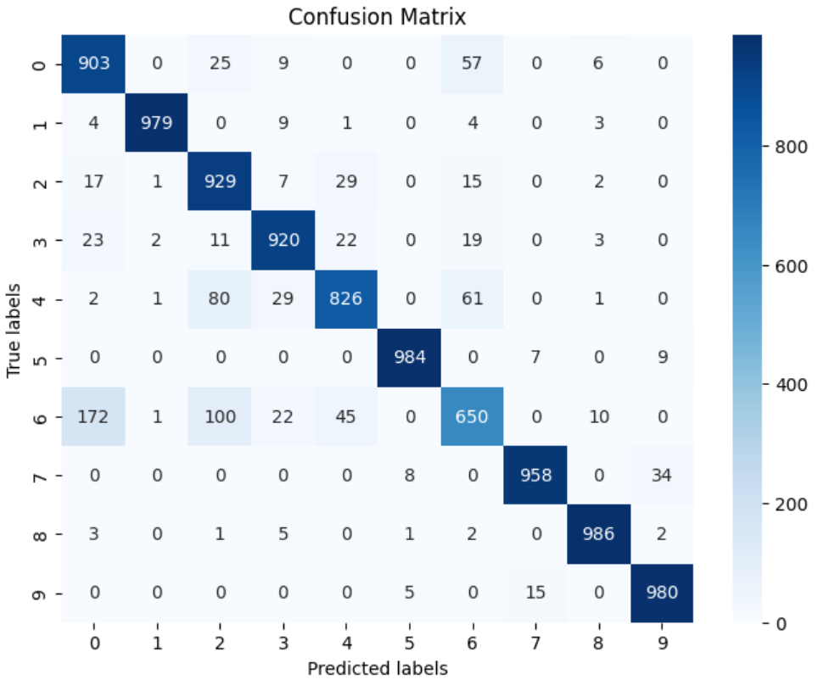
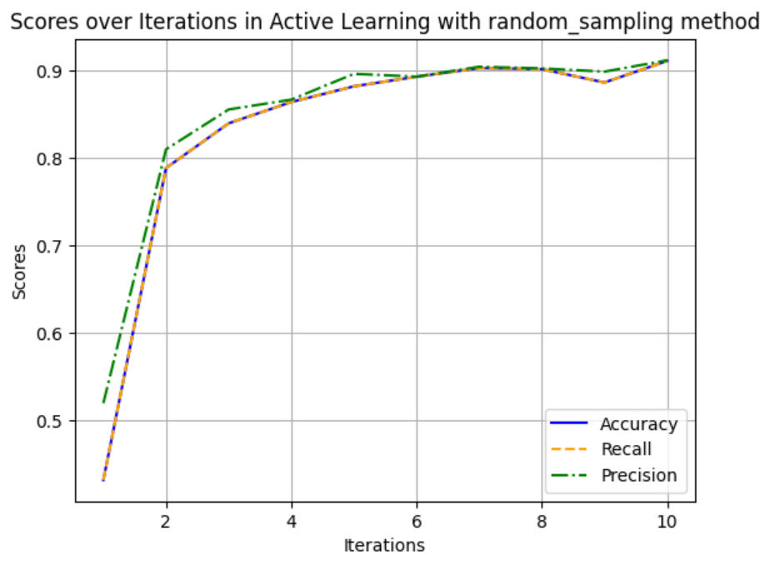
Evaluation
1- Minst Fashion Dataset
1.1- Random Sampling
Precision: 0.91
Recall: 0.91
F1-score: 0.91

Slide 20
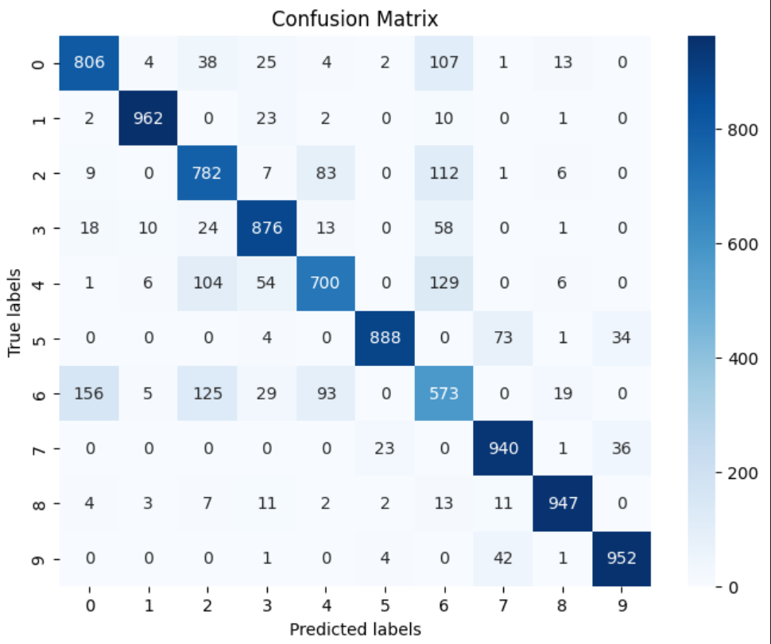
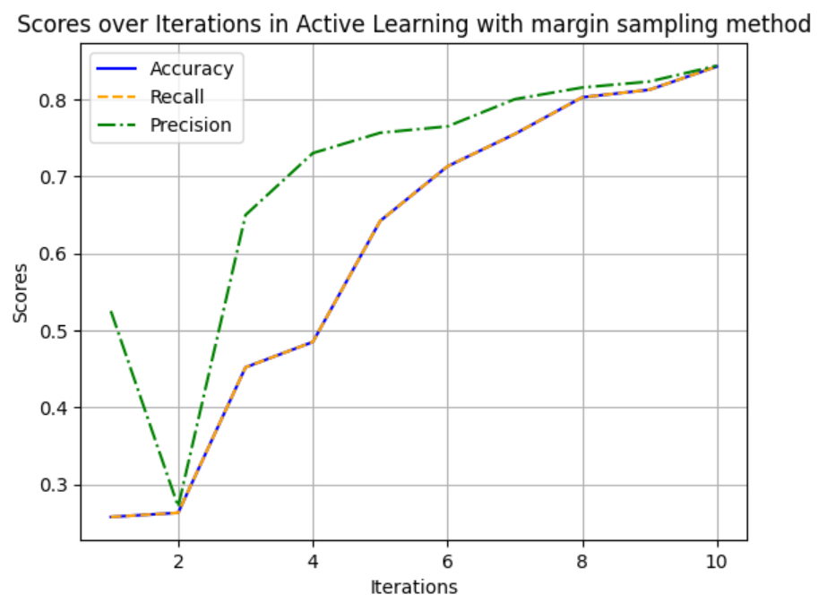
Evaluation
1- Minst Fashion Dataset
1.2- Margin Sampling
Precision: 0.843
Recall: 0.842
F1-score: 0.842

Slide 21
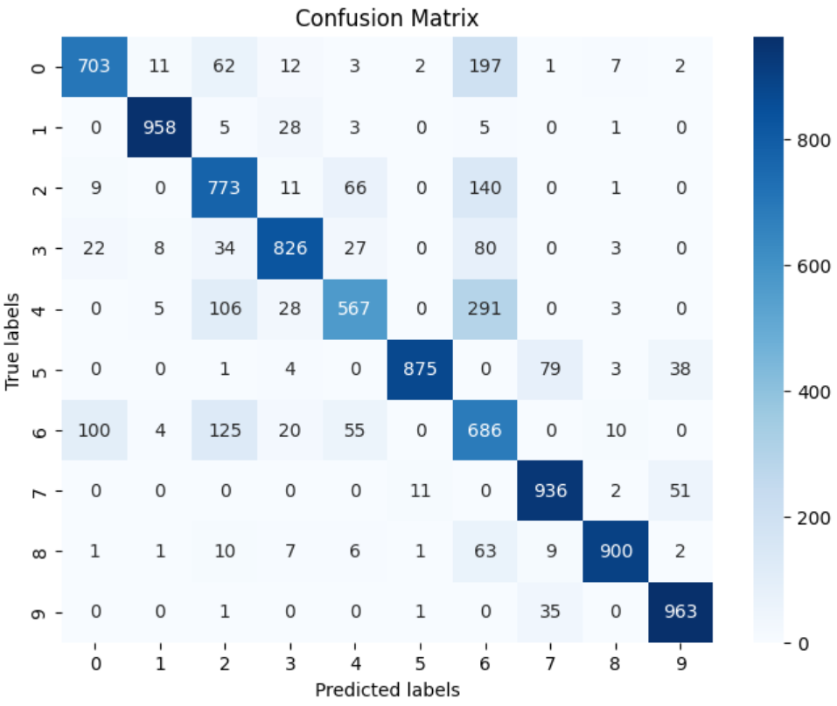
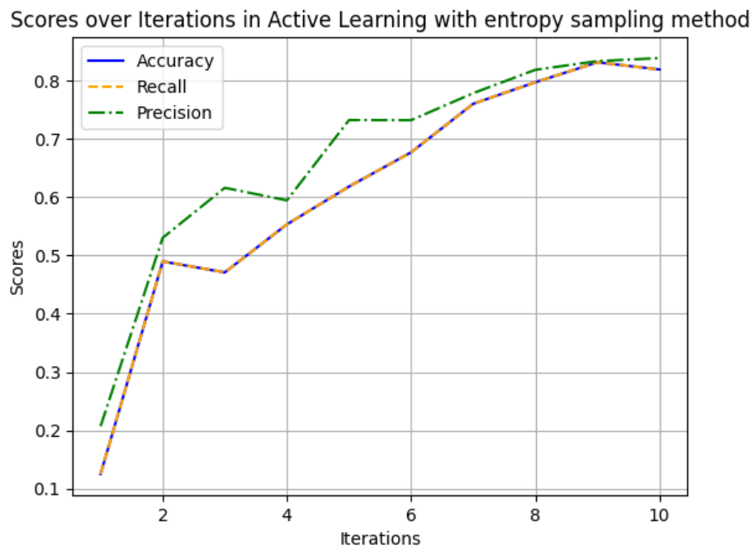
Evaluation
1- Minst Fashion Dataset
1.3- Entropy Sampling
Precision: 0.838
Recall: 0.818
F1-score: 0.823

Slide 22
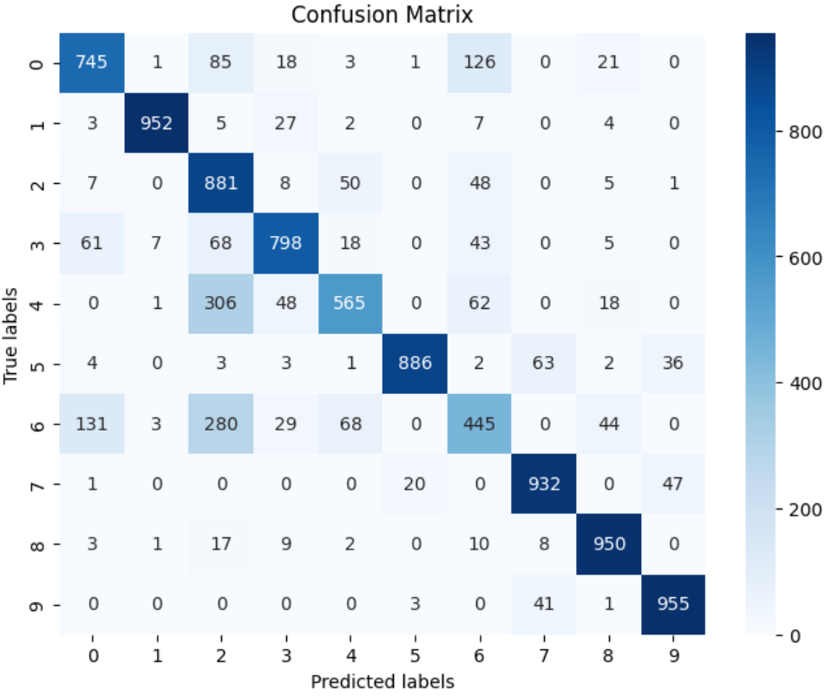
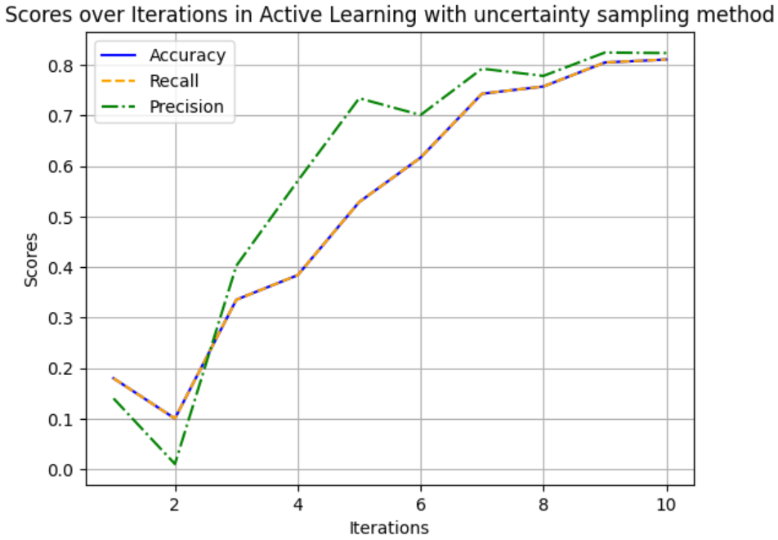
Evaluation
1- Minst Fashion Dataset
1.4- Uncertainty sampling
Precision: 0.823 Recall: 0.810
F1-score: 0.809

Slide 23
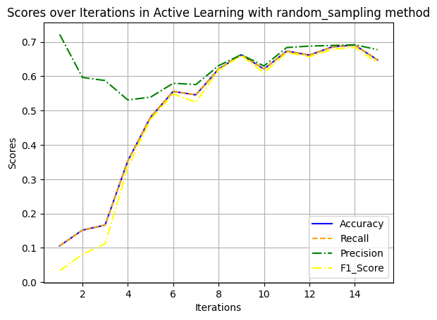
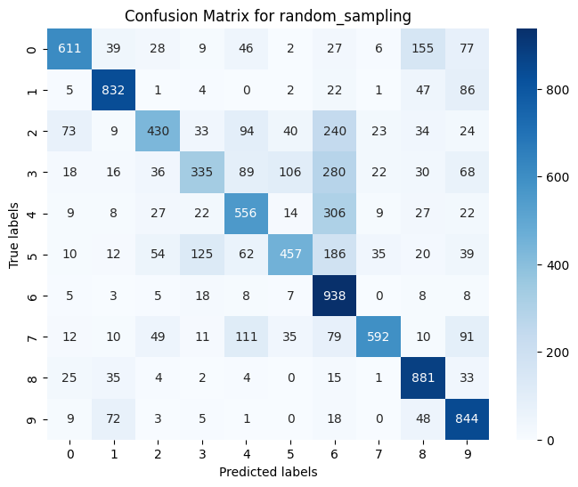
Evaluation
2- CIFAR-10 Dataset
2.1- Random Sampling
Precision:0.688
Recall: 0.679
F1-score:0.681

Slide 24
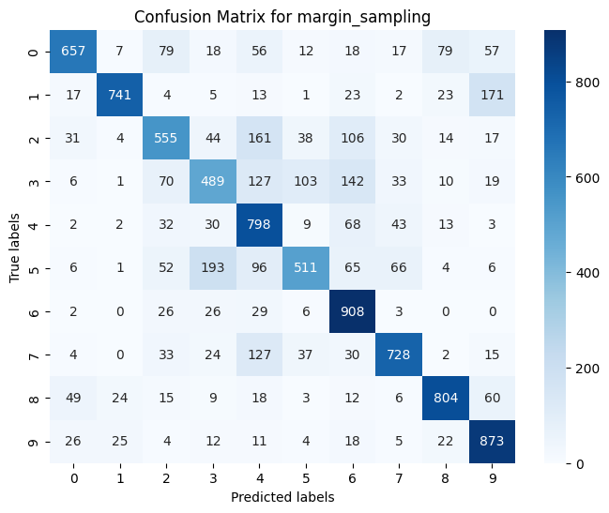
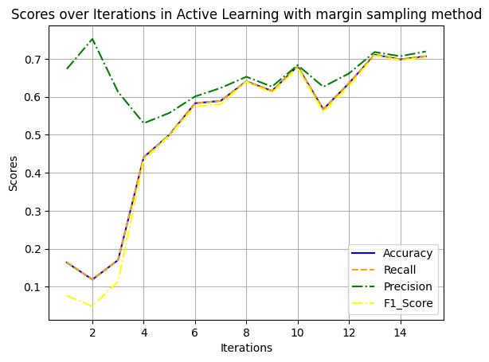
Evaluation
2- CIFAR-10 Dataset
2.2- Margin Sampling
Precision:0.673257
Recall: 0.655
F1-score: 0.649

Slide 25
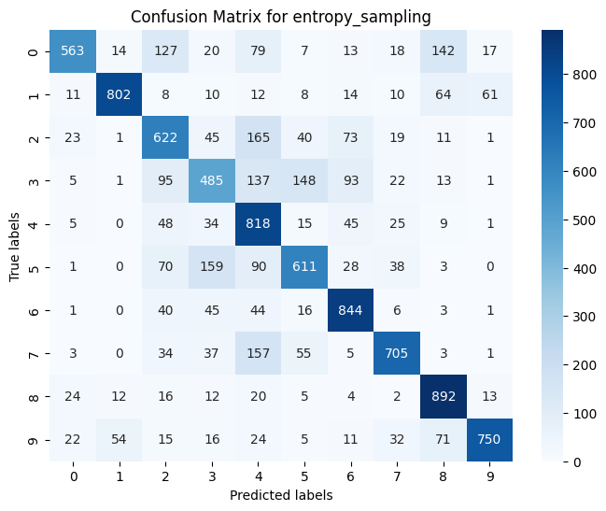
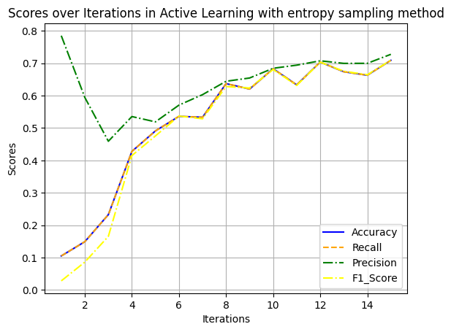
Evaluation
2- CIFAR-10 Dataset
2.3- Entropy Sampling
Precision: 0.622
Recall: 0.6127
F1-score: 0.605

Slide 26
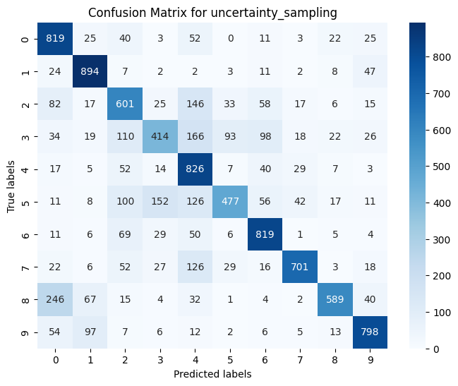
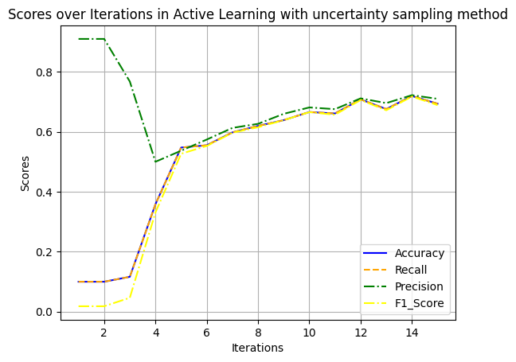
Evaluation
2- CIFAR-10 Dataset
2.4- Uncertainty sampling
Precision:0.615
Recall: 0.553
F1-score: 0.560

Slide 27
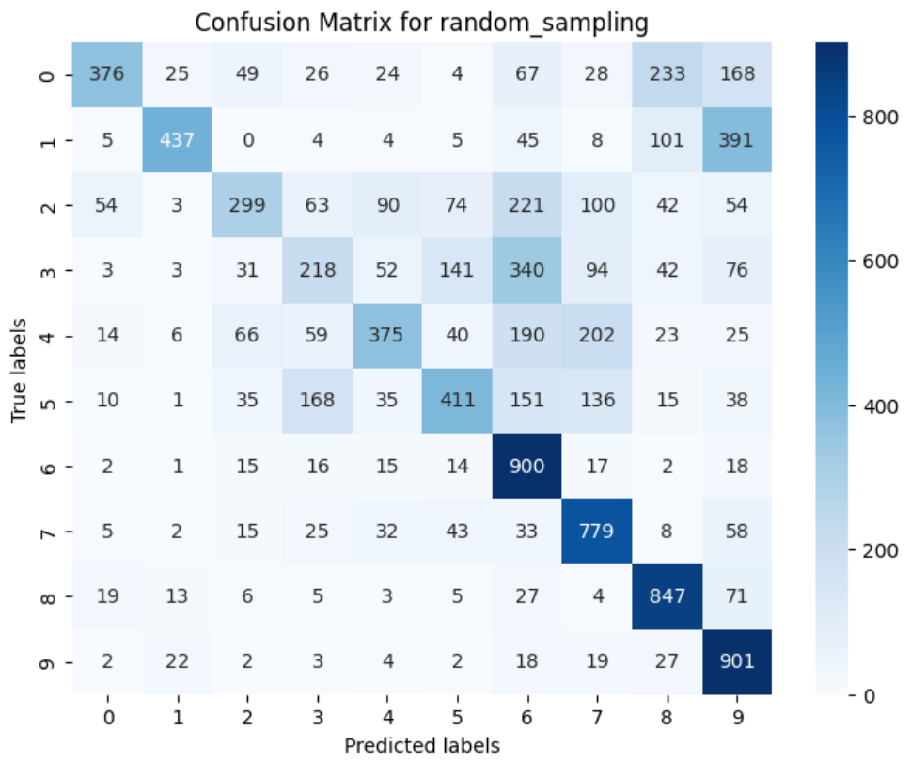
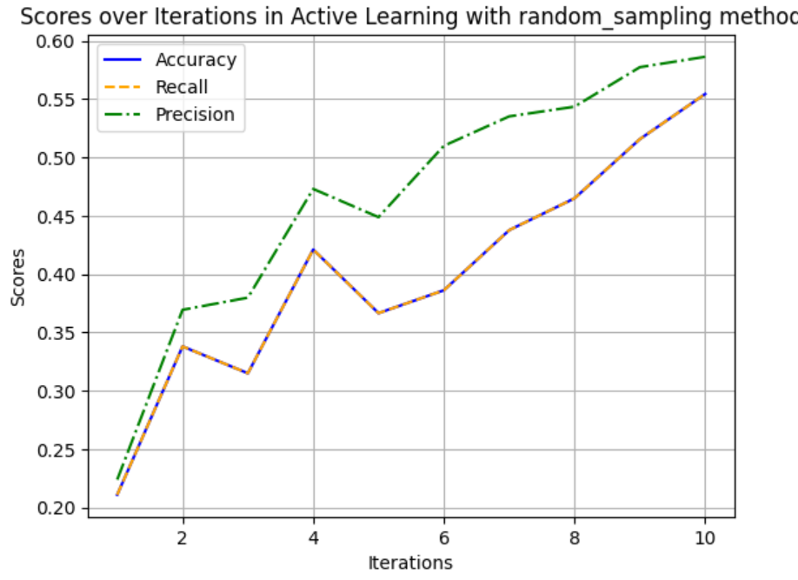
Evaluation
3- Imbalanced Minst Fashion Dataset
3.1- Random Sampling
Precision: 0.586
Recall: 0.554
F1-score: 0.530

Slide 28
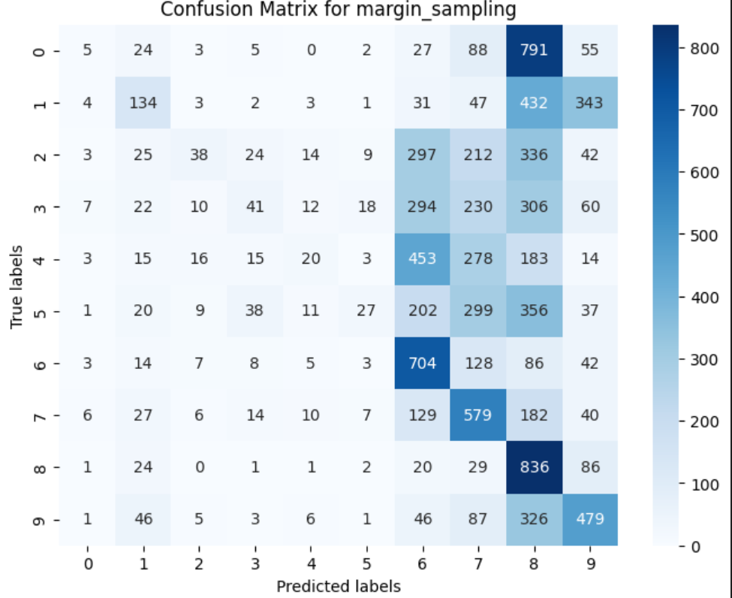
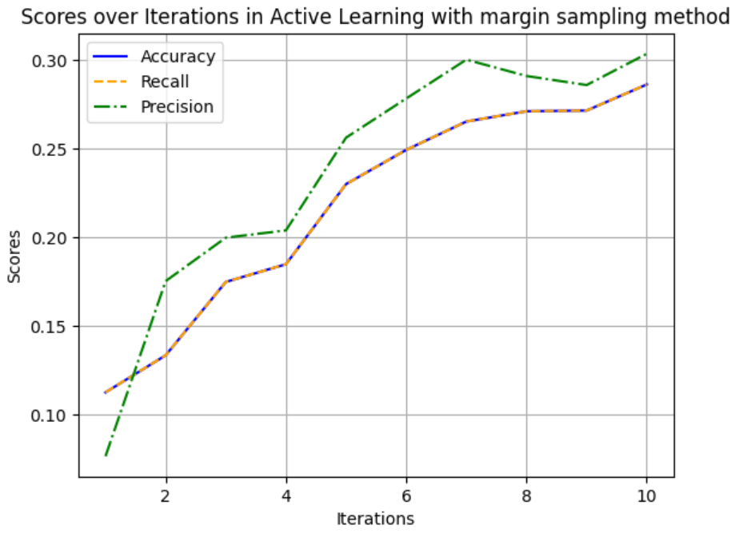
Evaluation
3- Imbalanced Minst Fashion Dataset
3.2- Margin Sampling
Precision: 0.303
Recall: 0.286
F1-score: 0.204

Slide 29
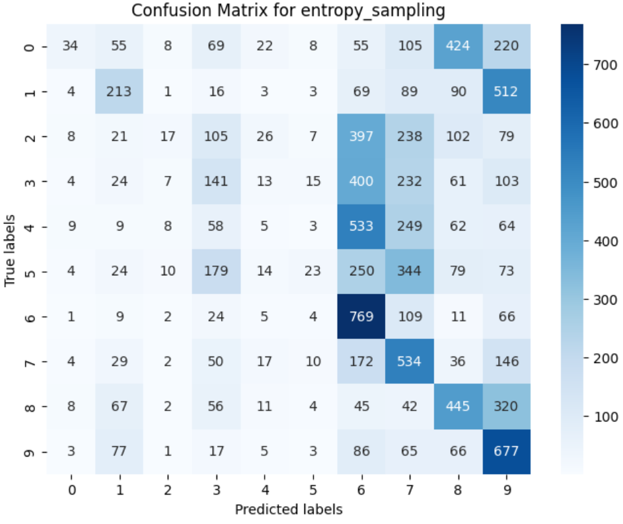
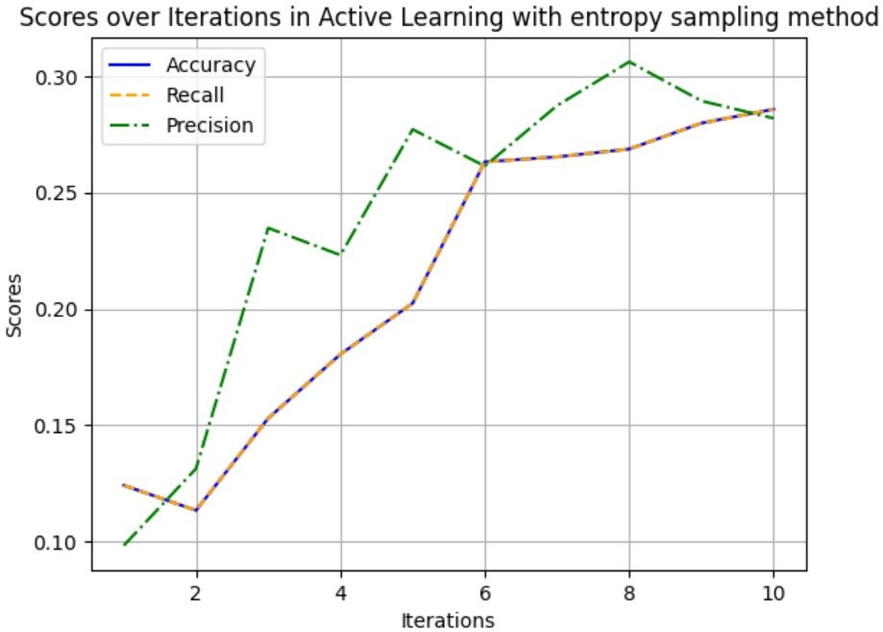
Evaluation
3- Imbalanced Minst Fashion Dataset
3.3- Entropy Sampling
Precision: 0.281 Recall: 0.2858
F1-score: 0.214

Slide 30
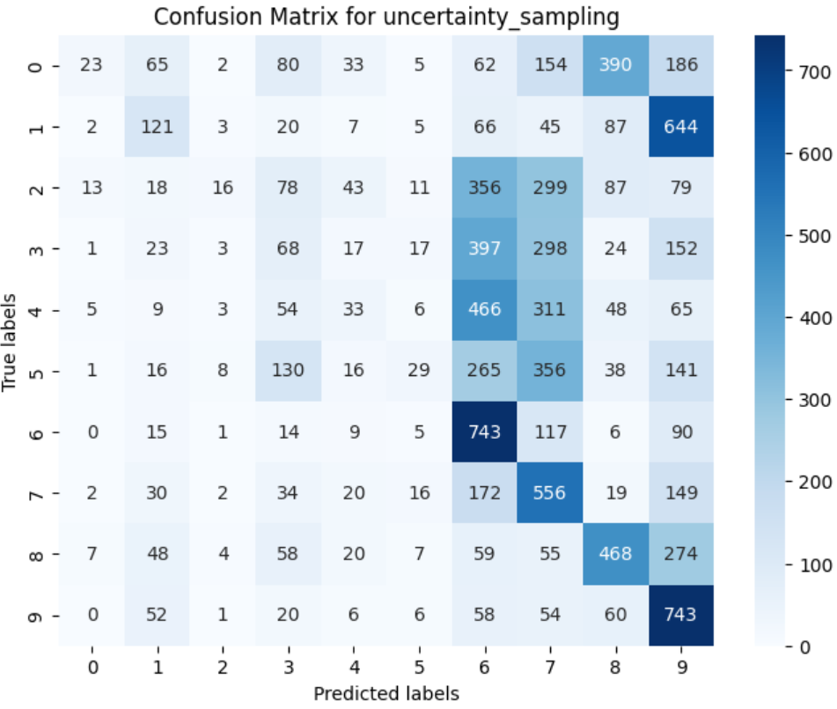
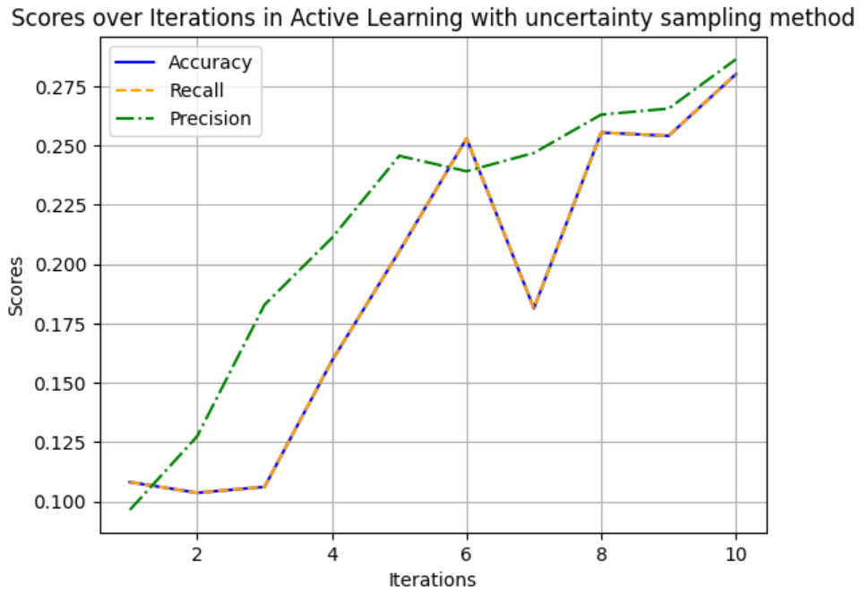
Evaluation
3- Imbalanced Minst Fashion Dataset
3.4- Uncertainty sampling
Precision: 0.286
Recall: 0.28
F1-score: 0.203

Slide 31
Thanks For Your Attention ☺
Evaluation
Active Learning Vs Passiv Learning
1- Minst Fashion Dataset
2- CIFAR-10 Dataset
3- Imbalanced Minst Fashion Dataset
Avg Active Learning :
Precision: 0.892
Recall: 0.890
F1-score: 0.897
Passive Learning :
Precision: 0.990
Recall: 0.990
F1-score: 0.987
Avg Active Learning :
Precision: 0.65
Recall: 0.63
F1-score: 0.625
Passive Learning :
Precision: 0.801
Recall: 0.799
F1-score: 0.799
Avg Active Learning :
Precision: 0.36.5
Recall: 0.35.5
F1-score: 0.285
Passive Learning :
Precision: 0.810
Recall: 0.804
F1-score: 0.805

Slide 32
Thanks For Your Attention ☺
Evaluation
Active Learning Vs Passiv Learning
1- Minst Fashion Dataset
2- CIFAR-10 Dataset
3- Imbalanced Minst Fashion Dataset
Avg Active Learning :
Precision: 0.852
Recall: 0.850
F1-score: 0.847
Passive Learning :
Precision: 0.812
Recall: 0.802
F1-score: 0.855
Avg Active Learning :
Precision: 0.65
Recall: 0.63
F1-score: 0.625
Passive Learning :
Precision: 0.801
Recall: 0.799
F1-score: 0.799
Avg Active Learning :
Precision: 0.36.5
Recall: 0.35.5
F1-score: 0.285
Passive Learning :
Precision: 0.810
Recall: 0.804
F1-score: 0.805

